Slide 1

Combining DDD and BDD to boost acceptance Testing and testing automation ^{Leonardo Souza Mattos} ^{#TAS19}
Philadelphia
April 5th, 2019

Slide 2


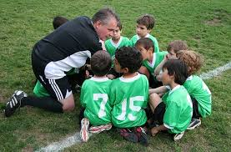
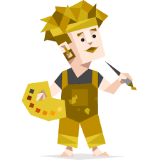

About me
Technical Coach
Developer
Soccer coach
Adventurer
IT Services
Principal Consultant
20+ years
In the industry
Licensed for kids
U10 - U16
Meyers Briggs
abbreviated test
Notes:
Meyers Briggs abbreviated test
16 personalities test

Slide 3

Have you heard this before?
“I tested it how you told me to”
“Acceptance criteria said this is expected”
”When you say ‘account’, you want to mean ‘client’, right?”
“I assumed it was fine”
”I have not tested with this input. I didn’t know it could happen”
“ I didn’t know what to test”
Notes:
Tell my personal story about transforming from Java application / migrating legacy app to Cloud :
I was hired as a consultant to redesign the application and their tests ( they had just a big Regression testing pack ) to a move it to Cloud, increasing the CD and all. I needed to understand what is the problem that application was trying to solve. What its the domain and all. So then I first went to see some documentation, obviously. And what I found? Besides that just a small part of the application was documented, they were not updated and the only thing I saw there were somehow technical : tech design, info about how to run the app and tests, how its deployed and so on. Nothing would tell me what the application does. Then, obviously, I went to validate their regression testing pack. am trying to understand their application behavior, the test cases they have

Slide 4

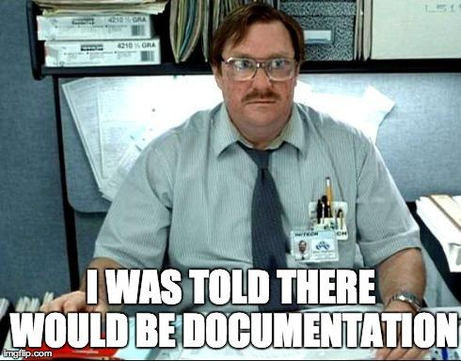

Slide 5
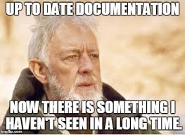
Notes:
One of the biggest challenges as engineers is to write working software and also keep an extensive documentation. Most engineers hate writing documentation, and after they published documentation on a wiki it will die a lonely death. We want to strive for writing a Living Documentation in an Ubiquitous Language. Practices like Domain Driven Design (DDD) and Behaviour Driven Development (BDD) can help you achieve this. Especially when we start writing code, it is really important for the quality of our software to start with tests describing what your application does. We want to write software with empathy in mind, software that is understandable for peers. While software developers are beginning to use the language of the domain (business language) more in their application code, most tests still contain a lot of technical language.

Slide 6
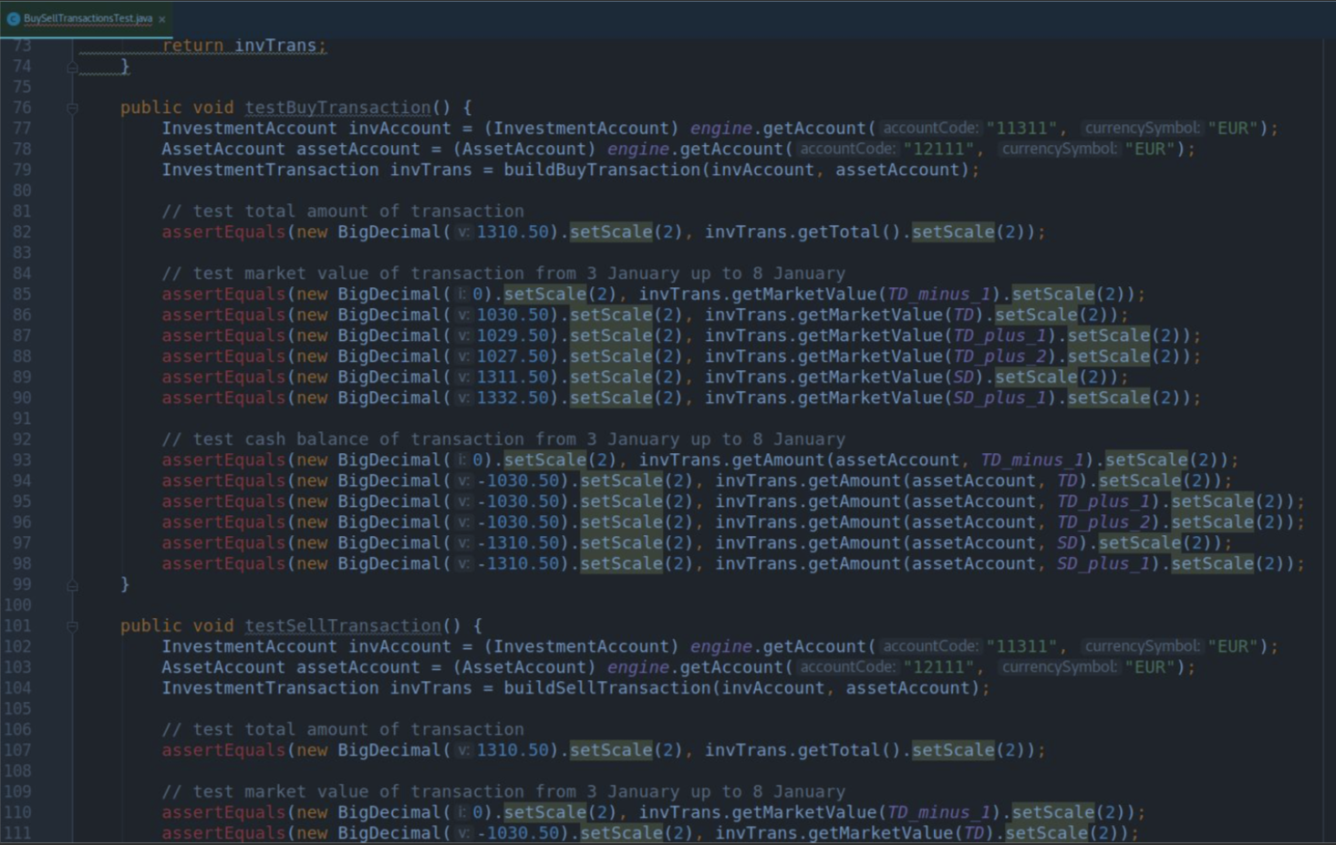
Notes:
Story : “here you can see the development was not done with TDD in mind. TDD is a mechanism that maes you design testable, your code testable and you tell through tests what you expect that application do or behaves.”
As software developers we have all been there: the moment you pull in a new project and you start with trying to figure out what it does. You start figuring out how the design works and eventually you want to know what a piece of software really does, so you open up the unit test and find something like the following test code functions:
[code language=”java”] public void testReservation() public void should_reserve() public void buildReservation() [/code]
It might be even worse, a critical software bug was reported, and you try to figure out where the bug came from. Tests like the one in the example do not tell you how the code should behave, it does not match the language the bug is reported in. Getting insights into what went wrong takes a lot of language/context switching and translating, which is time consuming and a waste of time.
You as experience testers can tell me, what would have helped in this situation? Please should on aspect.
What would have helped in this situation is that the tests are written in such a way that they tell you how the code should behave in the domain language. This way the model that the bug is reported in, and the tests and code have the same language and model.

Slide 7
What was wrong with that?
Tests weren’t saying what the application does
Created by developers, potentially after the code was done
If fails doesn’t tell me nothing. Need to go through the code to figure out something.

Slide 8

Is this TDD?
What is the domain?

Slide 9

[code language=”text”]
Scenario: Redirect user to originally requested page after logging in
Given a User "dave" exists with password "secret” And I am not logged in
When I navigate to the home page Then I am redirected to the login form
When I fill in "Username" with "dave" And I fill in "Password" with "secret" And I press "Login" Then I should be on the home page
[/code]
Notes:
Story : “But wait a minute!! This team had automated Regression testing, that needs to come from some sort of acceptance tests. I know they use Fitnesse and Selenium to write the tests, so, they for sure tell me how the application works. Nahn!!”

Slide 10
What was wrong with that?
Misunderstood BDD : just because its Gherkin does not mean its BDD
Design driven by the tool
Use the “new thing” without knowing how it really works.
Notes:
The same example usually applies to acceptance tests. In most cases these are still being owned by the testers, which in my opinion is a strange behaviour because the only one capable of breaking them are actually software developers. If you are lucky enough that the acceptance test are owned by the developers, you can start with crunching some domain knowledge trough these tests. Then you open up the tests only to find the following:
[code language=”text”] Scenario: Redirect user to originally requested page after logging in Given a User "dave" exists with password "secret" And I am not logged in When I navigate to the home page Then I am redirected to the login form When I fill in "Username" with "dave" And I fill in "Password" with "secret" And I press "Login" Then I should be on the home page [/code]
This is what we call the implementation pitfall. It is when software developers use a tool out of his or her context, in this case usually Cucumber. Reading this does not give you information about the behaviour of the system, only about how the behaviour is implemented. Of course it is better than no acceptance tests, but think about the consequences of this action. Usually the behaviour of a system does not change, there will only be new behaviour, or behaviour will be removed. The implementation details of the system is the only factor that changes. Every time this happens, we do not only need to change the system, but also the feature files and test code. As developers, we learn to create low coupling system, describing features as implementation in Gherkin files is high coupling, and something we really do not want! Besides, as a software developer I want the documentation to match the model and the language of the domain, which should not be the implementation!

Slide 11
What is the story?
What is the expected behavior?

Slide 12
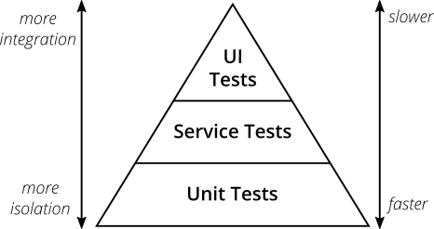
There are many testing pyramids
Notes:
Test pyramid misses the ( not useful map ). 3 important feedback loops : ideas, executable spec and unit tests.

Slide 13

What is the solution?

Slide 14

Domain language throughout tests, combining DDD and BDD
Its all about story:
DDD is about empathy. Its about knowing each other , knowing the model.
BDD is all about story and what is the story of what we are building.
Notes:
Science has proven that we learn and we improve by failing and experimenting. Examples are there everywhere in some sort of science. Including Continues Delivery. Examples on sciency are the special programs and the space run, and the boil temperature of the water for instance.
Focus now will be on tests. As the functional development is already there, improved with DDD and BDD, but the tests are little behind.

Slide 15
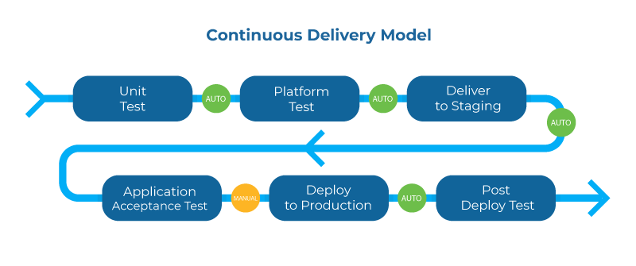
Testing pyramids are not a good map

Slide 16
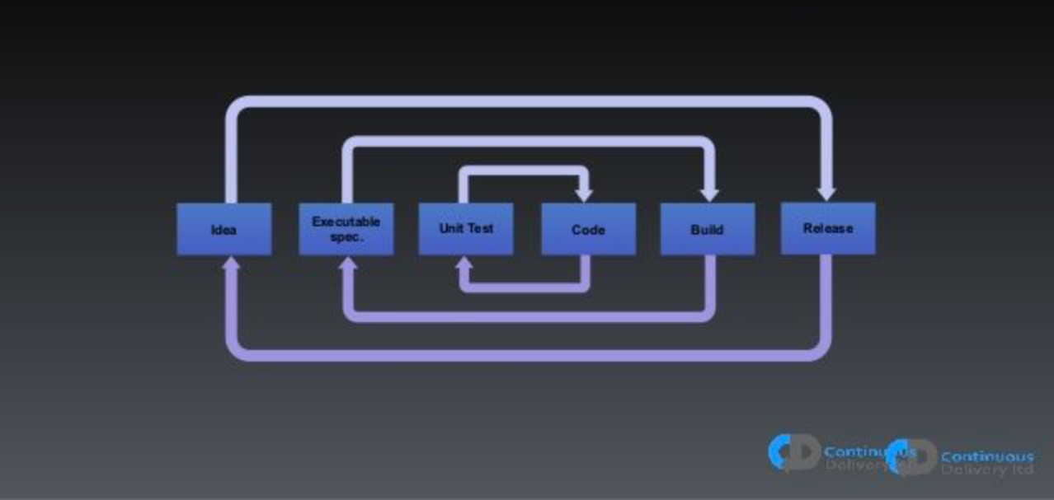
Feedback loops
Notes:
Important feedback loops
Ideas : validate ideas or initiates are good - A/B testing
Unit : I want to fail fast. Are the fastest test to be run
Acceptance : are my executable specs.

Slide 17

Navigation by public transport
As a commuter
I want to know the fastest route between two places,
In order to get to my destination as quickly as possible
4
Notes:
Science has proven that we learn and we improve by failing and experimenting. Examples are there everywhere in some sort of science. Including Continues Delivery. Examples on sciency are the special programs and the space run, and the boil temperature of the water for instance.
Focus now will be on tests. As the functional development is already there, improved with DDD and BDD, but the tests are little behind.

Slide 18
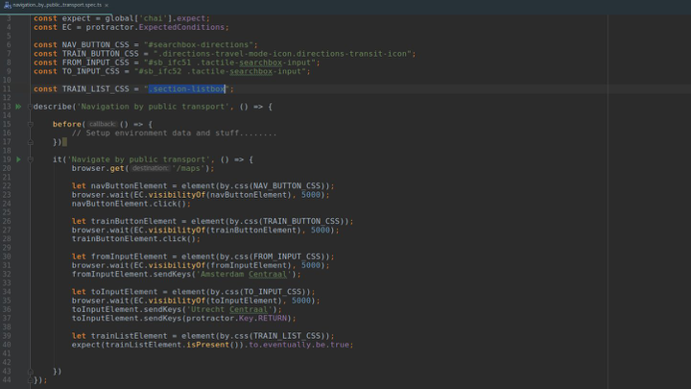
Notes:
This is webdriver. You can talk to it and it will click on your UI and you can select the browser. Its type script generated by a recorder tool with some changes.
First issue with it : if you don’t know the language you are screwed.
Second : you don’t know what its going on
What you see its people writing in Ghurken with Cucumber

Slide 19
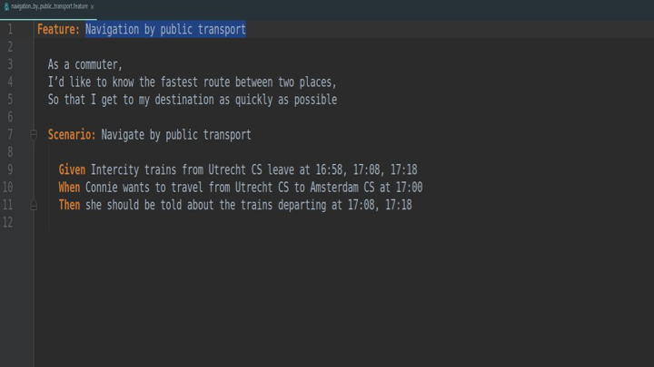
Notes:
This is a little bit better…. You have at least the intention. But you still don’t know the flow of the application. What is the implementation? Where the issue is? I want to have something more. I want to see the flow!!!

Slide 20
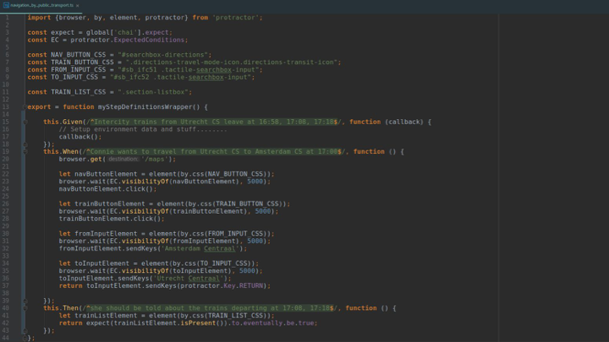
Notes:
BDD -> who owns the feature files? I see that Dev do all and then throw to QA that send back : on my machine works.
BDD needs to be done with all the team.. Testers embedded creating the acceptance test.
How we do it? We will see now.

Slide 21
DDD + BDD in practice: Feature Mapping!!
Notes:
John Smart done feature mapping.

Slide 22

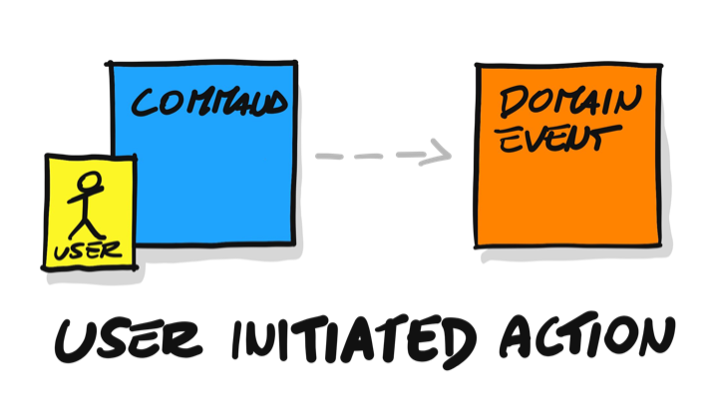
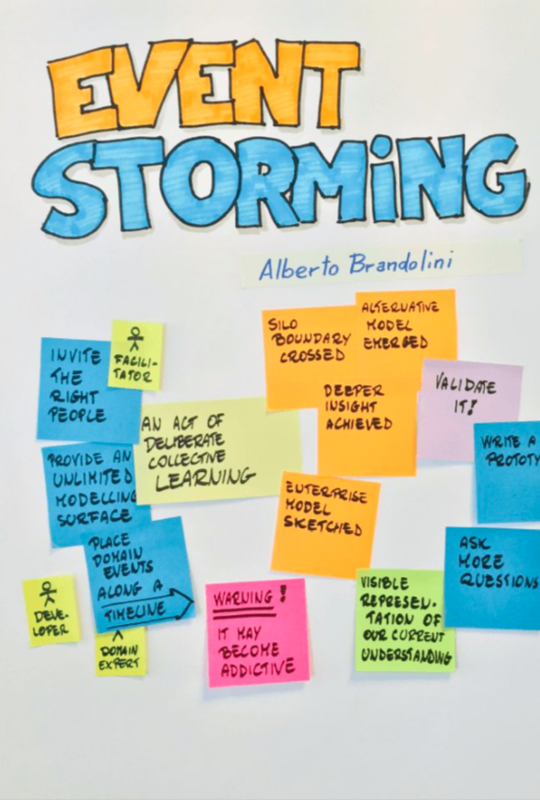
How feature mapping helps on acceptance testing
This technique is all about creating specification based on examples, communicating in human language what the software does. It’s a map on how is the flow of feature implementation
Applying event storming and “Examples and Rules”, and making the ”Spec by Example” embedded on your testing code
Notes:
Event Storming
Now for step 3 it is time to start Event Storming. Event Storming has five important concepts:
Command (Blue): Decision or action. Aggregate (Yellow): Local Logic Event (Orange): Domain Event Policy (Lilac): Reactive Logic (Whenever), Listener, Process Manager, Saga. Read Model (Green): Key Information
The basic Event Storm flow is: Command -> Aggregate -> Event -> Read Model or Policy.
If you want to know more about these concepts, I would recommend you to read the book about Event Storming or attend a Workshop Event Storming. I will not go into too much detail about Event Storming, but just enough for you to follow along.
So we start to Event Storm a naive flow for ordering movie tickets without defining the Aggregate yet. First, write down the outcome as an Event and try working from the start of the flow towards that event.
The most important part about this is that any discussion needs to be visualized, either by Event Storming or just by drawing pictures. When we are Event Storming, we usually start by giving examples. These examples should be written on a green sticky note and be placed on the left side of your Event Storming. We can start giving our Aggregates a name. It can happen that multiple models already start emerging here; put them beneath or next to the other one.
Examples and Rules
The next step is step 4; for now, we will use Example Mapping to keep it simple. The aim is to get as many examples as possible. If you want to go deeper and create a Feature Map that would be the best! You can read more about going deeper at the post about Feature Mapping.
When we are done, we want to pick out one or two rules with the scenarios that are most important and leave the other ones only in the back of our minds. It is time to go back to our Event Storm and check if our model is good enough to run the examples through. At this point, multiple branches and flows will start to emerge. This gives you the opportunity to see your model from different angles and create other models. You will probably see the same Aggregates in the same flow. The time has come to let go of the flow and start building towards modeling our Aggregates trough state-machines.

Slide 23







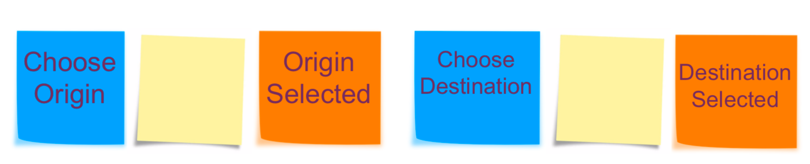
Event storming
Event Storming is a form of organizational anthropology; it’s all about discussing the flow of events in your organization and modelling that flow in an easy to understand way.
Notes:
A single event isn’t very exciting, so we need to consider events in term of flow — events over time. Orange stickies represent events. To model a business process we simply arrange events from left-to-right in time sequence. That’s it! Sounds simple? It is. That’s the point. There’s no unnecessary ceremony between you, your team, and an interesting discussion that yields results.

Slide 24
In our example

Slide 25
Example Mapping
This comes from Cucumber, from BDD
Discovery phase. Flipping out examples
Domain experts needs to be in the room
Get 4 coloured cards
Don’t think initially on Gerkhin. Goes like “friends episode names” : “The one when”
If there is discussion or questions, you park on pink cards if cannot be solved in 15 min or no experts
Notes:
Concrete examples are a tremendous way to help us explore the problem domain, and they make a great basis for our acceptance tests. But as we discuss these examples, there are other things coming out in the conversation that deserve to be captured too:
rules that summarise a bunch of examples, or express other agreed constraints about the scope of the story.
questions about scenarios where nobody in the conversations knows what the right outcome is. Or assumptions we're making in order to progress.
new user stories we discovered or sliced and deferred out of scope.
Example Mapping uses a pack of four coloured index cards and some pens to capture these different types of information as the conversation unfolds. As we talk, we capture them on index cards, and arrange them in a map:

Slide 26
Navigation by public transport
As a commuter
I want to know the fastest route between two places,
In order to get to my destination as quickly as possible
4
Notes:
Science has proven that we learn and we improve by failing and experimenting. Examples are there everywhere in some sort of science. Including Continues Delivery. Examples on sciency are the special programs and the space run, and the boil temperature of the water for instance.
Focus now will be on tests. As the functional development is already there, improved with DDD and BDD, but the tests are little behind.

Slide 27
Acceptance Criteria
Given Ultrech trains leave at 16:58, 17:08 and 17:18
When Connie wants to travel to Amsterdam at 17:00
Then the available trains are 17:08 and 17:18
Given Ultrech trains leave at 16:58, 17:08 and 17:18
When Connie wants to travel to Amsterdam at 18:00
Then no trains are available
And messase “ want to adjuste the travel time to latest train?” shows up
Notes:
Science has proven that we learn and we improve by failing and experimenting. Examples are there everywhere in some sort of science. Including Continues Delivery. Examples on sciency are the special programs and the space run, and the boil temperature of the water for instance.
Focus now will be on tests. As the functional development is already there, improved with DDD and BDD, but the tests are little behind.

Slide 28
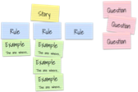
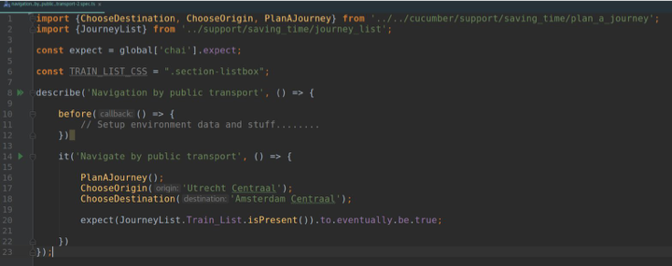

Slide 29
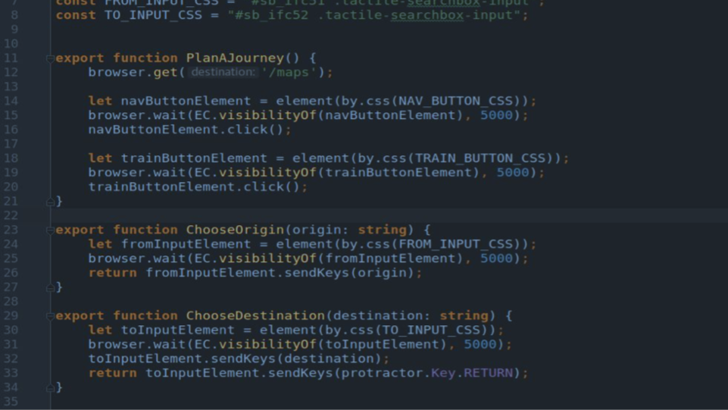
WebDriver

Slide 30
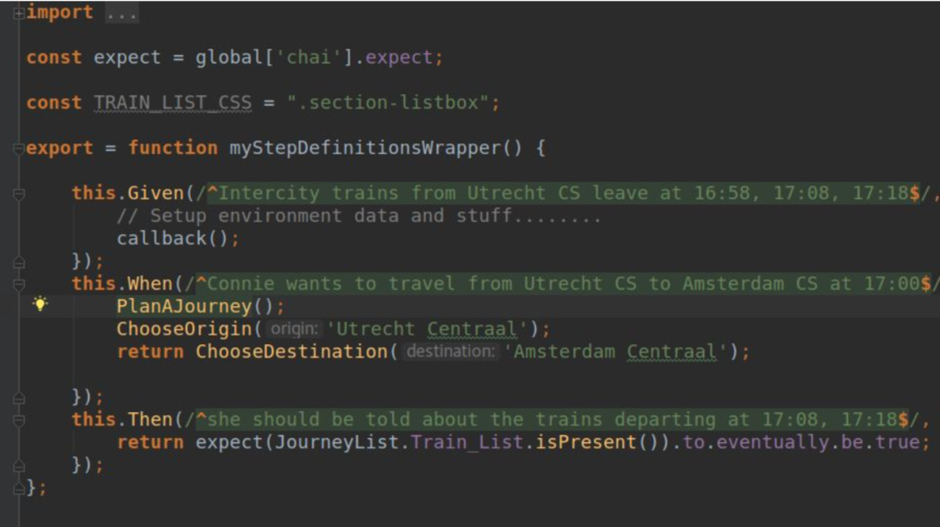
Cucumber

Slide 31
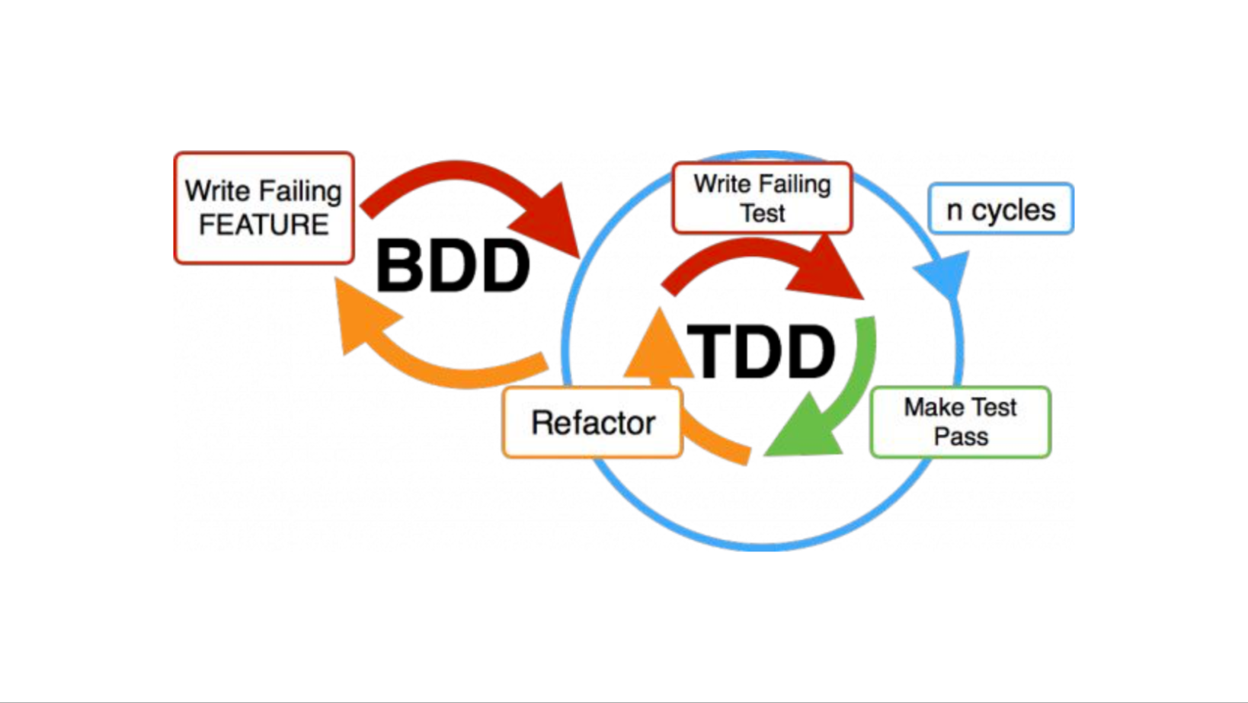
Conclusion
Enhance your acceptance testing with executable spec by example ( they can be written in Excel, Cucumber, Fitnesse, JSON files, etc…)
Empathy from DDD + Story from BDD + Science = Better testing via quicker feedback ( Your CD thanks you )
It can and should be done from all test levels
Notes:
Additional thinks:
The model and ubiquous language needs to flow throught the app and tests for everyone talk the same terms
Communication

Slide 32
Exit Criteria
How would be those concepts applied others testing types, like Unit Testing??

Slide 33

References
Adzic, Gojko (2011). Specification by example: How successful teams deliver the right software. Manning. ISBN 9781617290084.
Pugh, Ken (2011). Lean-Agile Acceptance Test Driven Development: Better Software Through Collaboration: A Tale of Lean-Agile Acceptance Test Driven Development. Addison Wesley. ISBN 978-0-321-71408-4.
Jump up to:ª ^{b} ^{c} Larman, Craig; Vodde, Bas (2010). Practices for Scaling Lean and Agile Development: Large, Multisite, and Offshore Product Development with Large-Scale Scrum. Pearson. ISBN 978-0-321-63640-9.
Jump up to:ª ^{b} Adzic, Gojko (2009). Bridging the Communication Gap: Specification by Example and Agile Acceptance Testing. Neuri. ISBN 0-9556836-1-0.
Crispin, Lisa; Gregory, Janet (2008). Agile Testing: A Practical Guide for Testers and Agile Teams. Addison Wesley. ISBN 978-0-321-53446-0.
Pattern Languages of Program Design 2. Addison-Wesley. 1996. ISBN 978-0-201-89527-8.
Ward Cunningham. "EPISODES: A Pattern Language of Competitive Development Part I". C2.com. Retrieved 2014-01-08.
Martin Fowler 18 March 2004 (2004-03-18). "SpecificationByExample". Martinfowler.com. Retrieved 2014-01-08.
Beck, K. (1999). Extreme Programming Explained: Embrace Change. Addison-Wesley. ISBN 978-0-321-27865-4.
Evans, Eric (2004). Domain-Driven Design:Tackling Complexity in the Heart of Software. Addison-Wesley. ISBN 0-321-12521-5.
Weinberg, Gerald; Gause, Donald (1989). Exploring Requirements: Quality Before Design. Dorset House. ISBN 0-932633-13-7.

